Slide 1
Title
Place and date

Slide 2
Goal of the game – degrade proteins

Slide 3
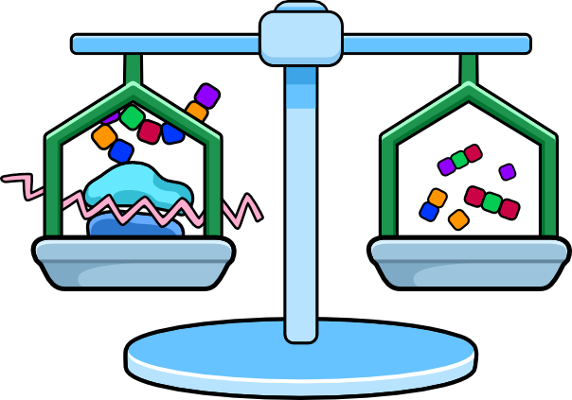
Equilibrium

Slide 4
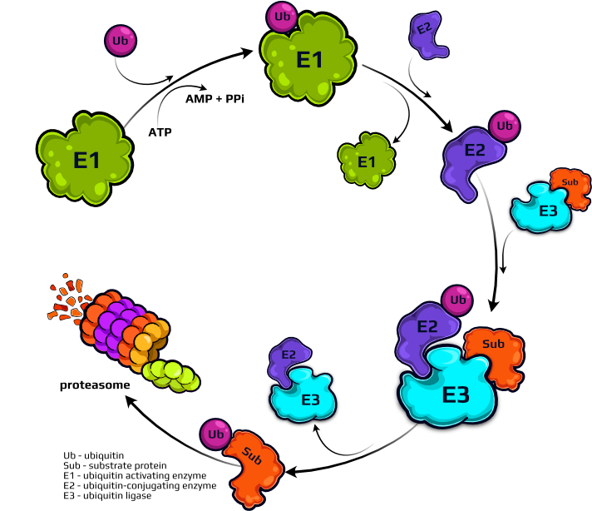
Ubiquitin-proteasome system

Slide 5
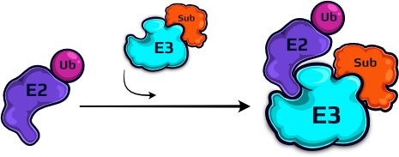
Game characters
E3 enzyme and E2-ubiquitin complex
Player takes on the role of an E3 enzyme
Proteasome

Slide 6
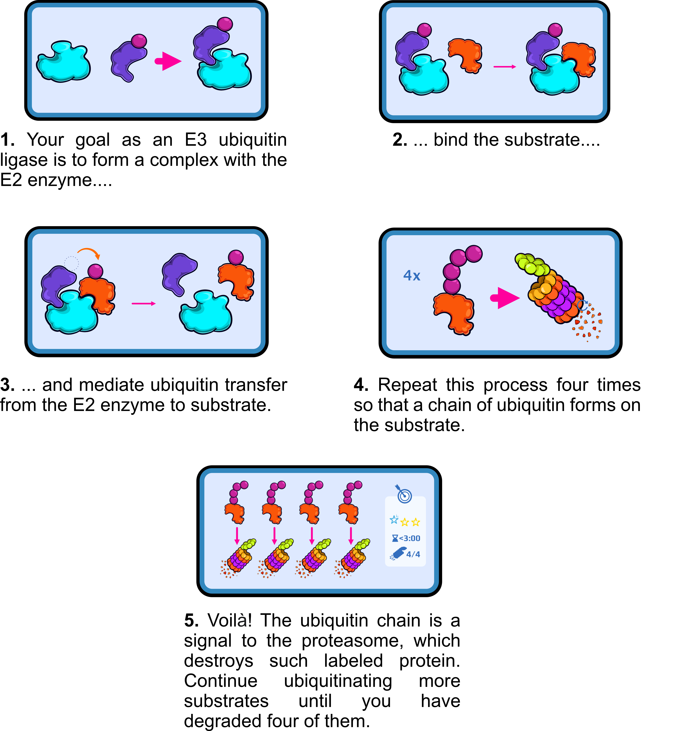
How to play

Slide 7
Link to the game:
https://degradator-game.com/

Slide 8
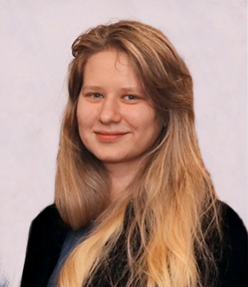
Authors
Natalia
Szulc
Anna
Olchowik
Patrycja
Jaszczak
Bartosz
Janiak
Wojciech
Pokrzywa
In collaboration with

